Slide 1
Ego Network Metrics

Slide 2
Ego networks
Ego: Central node
Ego

Slide 3
Ego networks
Ego: Central node
Alters: Nodes around ego
b
a
c
Ego
h
d
g
e
f

Slide 4
Ego networks
Ego: Central node
Alters: Nodes around ego
  Obligatory links from ego to every alter
b
a
c
Ego
h
d
g
e
f

Slide 5
Ego networks
Ego: Central node
Alters: Nodes around ego
  Obligatory links from ego to every alter
  Optional links from alter to alter
b
a
c
Ego
h
d
g
e
f

Slide 6
Ego networks
Ego: Central node
Alters: Nodes around ego
  Obligatory links from ego to every alter
  Optional links from alter to alter
The star subgraph contains all the ego-to-alter ties
b
a
c
Ego
h
d
g
e
f

Slide 7
Ego networks
Ego: Central node
Alters: Nodes around ego
  Obligatory links from ego to every alter
  Optional links from alter to alter
The star subgraph contains all the ego-to-alter ties
E_{ea} = {Ea, Eb, Ec, Ed, Ee, Eg, Ef, Eg, Eh}
b
a
c
Ego
h
d
g
e
f

Slide 8
Ego networks
Ego: Central node
Alters: Nodes around ego
  Obligatory links from ego to every alter
  Optional links from alter to alter
The star subgraph contains all the ego-to-alter ties
The alter-alter subgraph is the local network of people who are connected to ego
b
a
c
h
d
g
e
f

Slide 9
Ego networks
Ego: Central node
Alters: Nodes around ego
  Obligatory links from ego to every alter
  Optional links from alter to alter
The star subgraph contains all the ego-to-alter ties
The alter-alter subgraph is the local network of people who are connected to ego
  V = {a, b, c, d, e, f, g}
  E = {ab, ah, ag, bh, bg, de, dg, ef, fg, gh}
b
a
c
h
d
g
e
f

Slide 10
Ego network data
There are four pieces of information we need to compute the basic ego-network properties:
b
a
c
Ego
h
d
g
e
f

Slide 11
Ego network data
There are four pieces of information we need to compute the basic ego-network properties:
  The number of ego-to-alter ties
    The same as the number of alters!
b
a
c
Ego
h
d
g
e
f

Slide 12
Ego network data
There are four pieces of information we need to compute the basic ego-network properties:
  The number of ego-to-alter ties
    The same as the number of alters!
  The number of alter-to-alter ties
b
a
c
Ego
h
d
g
e
f

Slide 13
Ego network data
There are four pieces of information we need to compute the basic ego-network properties:
  The number of ego-to-alter ties
    The same as the number of alters!
  The number of alter-to-alter ties
  Sociodemographic characteristics of ego:
    Age, gender, racial identity, class, education
b
a
c
Ego
h
d
g
e
f

Slide 14
Ego network data
There are four pieces of information we need to compute the basic ego-network properties:
  The number of ego-to-alter ties
    The same as the number of alters!
  The number of alter-to-alter ties
  Sociodemographic characteristics of ego:
    Age, gender, racial identity, class, education
  Sociodemographic characteristics of alters:
    Age, gender, racial identity, class, education
b
a
c
Ego
h
d
g
e
f

Slide 15
Ego network properties
Size
  Number of ego-alter ties
Composition
  Proportion of certain types of alters
Diversity
  Variation in alter attributes
Homophily/Heterophily
  Ties to alter same/different from ego
Clustering
  Density of alter-alter network
b
a
c
Ego
h
d
g
e
f

Slide 16
Ego network properties
Measure | Ego-alter ties | Alter-Alter Ties | Attributes
Size | ✅
Diversity |  |  | ✅
Homophily | ✅ |  | ✅
Composition |  |  | ✅
Clustering |  | ✅

Slide 17
Ego network properties: Size
Tells us whether your ego network is large or small
Given by either:
  Number of ego-alter-ties
  Number of alters
b
b
b
b
c
a
h
Ego
d
Ego
Ego
h
Ego
d
h
d
g
e
g
e
f
f
f
Size = 7
Size = 6
Size = 2
Size = 4

Slide 18
Ego network properties: Size
Tells us whether your ego network is large or small
Given by either:
  Number of ego-alter-ties
  Number of alters
b
b
b
b
c
a
h
Ego
d
Ego
Ego
h
Ego
d
h
d
g
e
g
e
f
f
f
Size = 7
Size = 6
Size = 2
Size = 4

Slide 19
Ego networks: Composition
Tell us whether your ego network is dominated by one category of alters
Given by the proportion of alters who belong to a certain category:
    Kin, neighbors, co-workers
    Gender, race, education
Kin
Non-Kin
b
b
b
b
a
c
a
c
a
c
a
c
Ego
Ego
Ego
h
Ego
d
h
d
h
d
h
d
g
e
g
e
g
e
g
e
f
f
f
f
Prop(Kin) = ⅜ = 0.38
Prop(Kin) = ⅝= 0.63
Prop(Kin) = ⅛ = 0.13
Prop(Kin) = ⅞= 0.88

Slide 20
Ego networks: Composition
Tell us whether your ego network is dominated by one category of alters
  Differentiates between ego-networks that are heavy on some alter category from those that are light
  E.g., Kin-heavy ego networks
Kin
Non-Kin
b
b
b
b
a
c
a
c
a
c
a
c
Ego
Ego
Ego
h
Ego
d
h
d
h
d
h
d
g
e
g
e
g
e
g
e
f
f
f
f
Prop(Kin) = ⅜ = 0.38
Prop(Kin) = ⅝= 0.63
Prop(Kin) = ⅛ = 0.13
Prop(Kin) = ⅞= 0.88

Slide 21
Ego networks: Homophily
Tells us whether the people in your ego-network are the same or different from you based on some sociodemographic characteristic
  E.g., Age, Race, Gender, Education, Ethnicity, Nationality
Given by the EI Homophily Index:
b
a
c
Ego
h
d
g
e
f

Slide 22
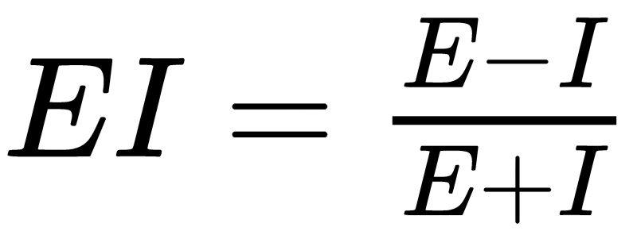
Ego networks: Homophily
Tells us whether the people in your ego-network are the same or different from you based on some sociodemographic characteristic
  E.g., Age, Race, Gender, Education, Ethnicity, Nationality
Given by the EI Homophily Index:
b
a
c
Ego
h
d
g
e
f

Slide 23
Ego networks: Homophily
Tells us whether the people in your ego-network are the same or different from you based on some sociodemographic characteristic
  E.g., Age, Race, Gender, Education, Ethnicity, Nationality
Given by the EI Homophily Index:
E = Number of “External” (different from you) alters
b
a
c
Ego
h
d
g
e
f

Slide 24
Ego networks: Homophily
Tells us whether the people in your ego-network are the same or different from you based on some sociodemographic characteristic
  E.g., Age, Race, Gender, Education, Ethnicity, Nationality
Given by the EI Homophily Index:
E = Number of “External” (different from you) alters
I = Number of “Internal” (same as you) alters
b
a
c
Ego
h
d
g
e
f

Slide 25
Ego networks: Homophily
Tells us whether the people in your ego-network are the same or different from you based on some sociodemographic characteristic
  E.g., Age, Race, Gender, Education, Ethnicity, Nationality
Given by the EI Homophily Index:
E = Number of “External” (different from you) alters
I = Number of “Internal” (same as you) alters
  E = 3
  I = 5
b
a
c
Ego
h
d
g
e
f

Slide 26
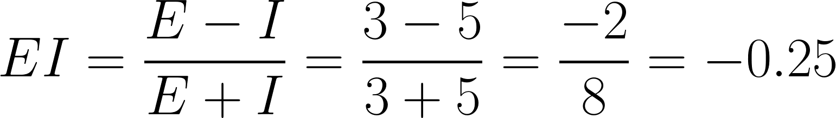
Ego networks: Homophily
Tells us whether the people in your ego-network are the same or different from you based on some sociodemographic characteristic
  E.g., Age, Race, Gender, Education, Ethnicity, Nationality
Given by the EI Homophily Index:
E = Number of “External” (different from you) alters
I = Number of “Internal” (same as you) alters
  E = 3
  I = 5
b
a
c
Ego
h
d
g
e
f

Slide 27
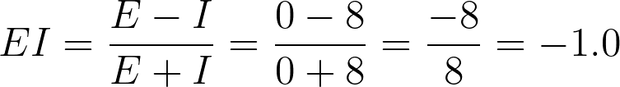
Ego networks: Homophily
Tells us whether the people in your ego-network are the same or different from you based on some sociodemographic characteristic
  E.g., Age, Race, Gender, Education, Ethnicity, Nationality
Given by the EI Homophily Index:
A negative EI indicates preference for “internal” ties
  An ego network with an EI of -1.0 has maximum homophily!
b
a
c
Ego
h
d
g
e
f

Slide 28
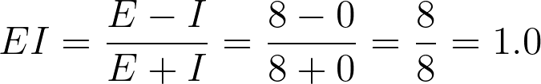
Ego networks: Homophily
Tells us whether the people in your ego-network are the same or different from you based on some sociodemographic characteristic
  E.g., Age, Race, Gender, Education, Ethnicity, Nationality
Given by the EI Homophily Index:
A positive EI indicates preference for “external” ties
  An ego network with an EI of 1.0 has maximum heterophily!
b
a
c
Ego
h
d
g
e
f

Slide 29
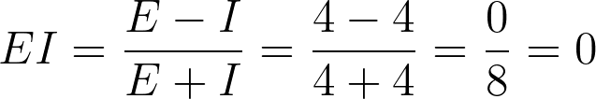
Ego networks: Homophily
Tells us whether the people in your ego-network are the same or different from you based on some sociodemographic characteristic
  E.g., Age, Race, Gender, Education, Ethnicity, Nationality
Given by the EI Homophily Index:
An EI score of 0 indicates no preference
  Equal number of internal and external ties!
b
a
c
Ego
h
d
g
e
f

Slide 30
Ego networks: Diversity
Tells us whether you tend to connect with a wide range of others based on some sociodemographic characteristic
  E.g., Age, Race, Gender, Education, Ethnicity, Nationality
Given by Blau’s Index of heterogeneity (H):
b
a
c
Ego
h
d
g
e
f

Slide 31
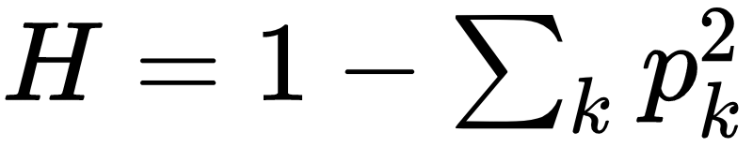
Ego networks: Diversity
Tells us whether you tend to connect with a wide range of others based on some sociodemographic characteristic
  E.g., Age, Race, Gender, Education, Ethnicity, Nationality
Given by Blau's Index of heterogeneity (H):
b
a
c
Ego
h
d
g
e
f

Slide 32
Ego networks: Diversity
Tells us whether you tend to connect with a wide range of others based on some sociodemographic characteristic
  E.g., Age, Race, Gender, Education, Ethnicity, Nationality
Given by Blau's Index of heterogeneity (H):
Steps:
b
a
c
Ego
h
d
g
e
f

Slide 33
Ego networks: Diversity
Tells us whether you tend to connect with a wide range of others based on some sociodemographic characteristic
  E.g., Age, Race, Gender, Education, Ethnicity, Nationality
Given by Blau's Index of heterogeneity (H):
Steps:
  Sum the squared proportions (p²) alters from each group (k)
b
a
c
Ego
h
d
g
e
f

Slide 34
Ego networks: Diversity
Tells us whether you tend to connect with a wide range of others based on some sociodemographic characteristic
  E.g., Age, Race, Gender, Education, Ethnicity, Nationality
Given by Blau's Index of heterogeneity (H):
Steps:
  Sum the squared proportions (p²) alters from each group (k)
  Subtract from 1.0
b
a
c
Ego
h
d
g
e
f

Slide 35
Ego networks: Diversity
Tells us whether you tend to connect with a wide range of others based on some sociodemographic characteristic
  E.g., Age, Race, Gender, Education, Ethnicity, Nationality
Given by Blau's Index of heterogeneity (H):
Steps:
  Sum the squared proportions (p²) alters from each group (k)
  Subtract from 1.0
H = 1 − (1/8² + 2/8² + 5/8²)
b
a
c
Ego
h
d
g
e
f

Slide 36
Ego networks: Diversity
Tells us whether you tend to connect with a wide range of others based on some sociodemographic characteristic
  E.g., Age, Race, Gender, Education, Ethnicity, Nationality
Given by Blau's Index of heterogeneity (H):
Steps:
  Sum the squared proportions (p²) alters from each group (k)
  Subtract from 1.0
H = 1 − (1/8² + 2/8² + 5/8²)
H = 1 − (0.13² + 0.25² + 0.62²)
b
a
c
Ego
h
d
g
e
f

Slide 37
Ego networks: Diversity
Tells us whether you tend to connect with a wide range of others based on some sociodemographic characteristic
  E.g., Age, Race, Gender, Education, Ethnicity, Nationality
Given by Blau's Index of heterogeneity (H):
Steps:
  Sum the squared proportions (p²) alters from each group (k)
  Subtract from 1.0
H = 1 − (1/8² + 2/8² + 5/8²)
H = 1 − (0.13² + 0.25² + 0.62²)
H = 1 − (0.02 + 0.06 + 0.38) = 1 − 0.46 = 0.54
b
a
c
Ego
h
d
g
e
f

Slide 38
Ego networks: Diversity
Tells us whether you tend to connect with a wide range of others based on some sociodemographic characteristic
  E.g., Age, Race, Gender, Education, Ethnicity, Nationality
Given by Blau's Index of heterogeneity (H):
Steps:
  Sum the squared proportions (p²) alters from each group (k)
  Subtract from 1.0
H = 1 − (3/8² + 2/8² + 1/8 + 2/8²)
H = 1 − (0.38² + 0.25² + 0.13² + 0.25²)
H = 1 − (0.14 + 0.06 + 0.02 + 0.06) = 1 − 0.28 = 0.72
b
a
c
Ego
h
d
g
e
f

Slide 39
Ego networks: Diversity
Tells us whether you tend to connect with a wide range of others based on some sociodemographic characteristic
  E.g., Age, Race, Gender, Education, Ethnicity, Nationality
Given by Blau's Index of heterogeneity (H):
Interpretation:
  The more diverse the ego network the closer H is to 1.0!
  Make sense!
H = 1 − (3/8² + 2/8² + 1/8 + 2/8²)
H = 1 − (0.38² + 0.25² + 0.13² + 0.25²)
H = 1 − (0.14 + 0.06 + 0.02 + 0.06) = 1 − 0.28 = 0.72
b
a
c
Ego
h
d
g
e
f

Slide 40
Ego networks: Diversity
Tells us whether you tend to connect with a wide range of others based on some sociodemographic characteristic
  E.g., Age, Race, Gender, Education, Ethnicity, Nationality
Given by Blau's Index of heterogeneity (H):
Interpretation:
  A completely homogeneous ego-network has H equal to 0
  Makes sense because there’s no diversity among alters!
H = 1 − (8/8²)
H = 1 − (1²)
H = 1 − 1 = 0
b
a
c
Ego
h
d
g
e
f

Slide 41
Ego networks: Diversity
Tells us whether you tend to connect with a wide range of others based on some sociodemographic characteristic
  E.g., Age, Race, Gender, Education, Ethnicity, Nationality
Given by Blau's Index of heterogeneity (H):
H is at a maximum (1.0 − 1/k) when:
  Each of your alters belongs to a different group
  Makes sense!
H = 1 − (1/8² + 1/8² + 1/8² + 1/8² + 1/8² + 1/8² + 1/8² + 1/8²)
H = 1 − (1/8² X 8) = 1 − (8/8²)
H = 1 − (8/64) = 1 − (1/8) = 1 − 0.13 = 0.87
b
a
c
Ego
h
d
g
e
f

Slide 42
Ego networks: Clustering
Tell us the extent to which:
  Your alters are interconnected among themselves (e.g., know one another)
Versus
  Your alters are not connected among themselves (e.g., are strangers to one another)
Given by the Clustering Coefficient (CC_{i})
b
a
c
Ego
h
d
g
e
f

Slide 43
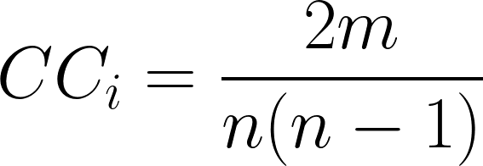
Ego networks: Clustering
Tell us the extent to which:
  Your alters are interconnected among themselves (e.g., know one another)
Versus
  Your alters are not connected among themselves (e.g., are strangers to one another)
Given by the Clustering Coefficient (CC_{i})
b
a
c
Ego
h
d
g
e
f

Slide 44
Ego networks: Clustering
Tell us the extent to which:
  Your alters are interconnected among themselves (e.g., know one another)
Versus
  Your alters are not connected among themselves (e.g., are strangers to one another)
Given by the Clustering Coefficient (CC_{i})
Pieces of Information you need:
  Number of alter-to-alter edges (m)
  Number of alters (n)
b
a
c
Ego
h
d
g
e
f

Slide 45
Ego networks: Clustering
Tell us the extent to which:
  Your alters are interconnected among themselves (e.g., know one another)
Versus
  Your alters are not connected among themselves (e.g., are strangers to one another)
Given by the Clustering Coefficient (CC_{i})
Pieces of Information you need:
  Number of alter-to-alter edges (m)
  Number of alters (n)
  Don’t care about the ego-to-alter links!
b
a
c
Ego
h
d
g
e
f

Slide 46
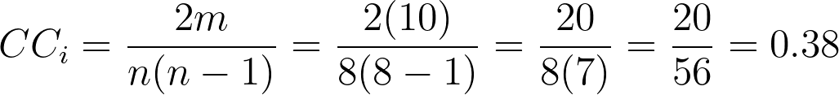
Ego networks: Clustering
Tell us the extent to which:
  Your alters are interconnected among themselves (e.g., know one another)
Versus
  Your alters are not connected among themselves (e.g., are strangers to one another)
Given by the Clustering Coefficient (CC_{i})
Pieces of Information you need:
  Number of alter-to-alter edges (m)
  Number of alters (n)
  Don’t care about the ego-to-alter links!
m = 10
n = 8
b
a
c
Ego
h
d
g
e
f

Slide 47
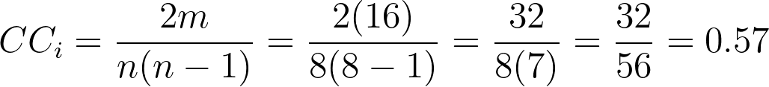
Ego networks: Clustering
Tell us the extent to which:
  Your alters are interconnected among themselves (e.g., know one another)
Versus
  Your alters are not connected among themselves (e.g., are strangers to one another)
Given by the Clustering Coefficient (CC_{i})
Interpretation:
  More alter-alter connections increase ego’s clustering coefficient
  Less alter-alter connections decrease it
  Maximum of 1.0 and minimum of 0
m = 16
n = 8
b
a
c
Ego
h
d
g
e
f

Slide 48
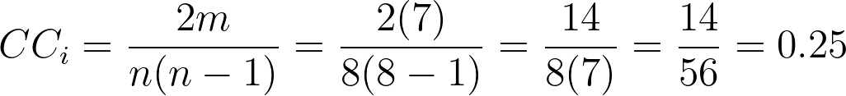
Ego networks: Clustering
Tell us the extent to which:
  Your alters are interconnected among themselves (e.g., know one another)
Versus
  Your alters are not connected among themselves (e.g., are strangers to one another)
Given by the Clustering Coefficient (CC_{i})
Interpretation:
  More alter-alter connections increase ego’s clustering coefficient
  Less alter-alter connections decrease it
  Maximum of 1.0 and minimum of 0
m = 7
n = 8
b
a
c
Ego
h
d
g
e
f

Slide 49
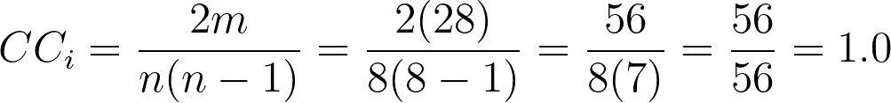
Ego networks: Clustering
Tell us the extent to which:
  Your alters are interconnected among themselves (e.g., know one another)
Versus
  Your alters are not connected among themselves (e.g., are strangers to one another)
Given by the Clustering Coefficient (CC_{i})
Interpretation:
  More alter-alter connections increase ego’s clustering coefficient
  Less alter-alter connections decrease it
  Maximum of 1.0 (Every one of your friends know one another)
m = 28
n = 8
b
a
c
Ego
h
d
g
e
f

Slide 50
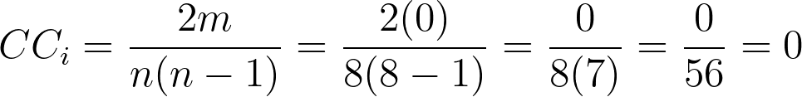
Ego networks: Clustering
Tell us the extent to which:
  Your alters are interconnected among themselves (e.g., know one another)
Versus
  Your alters are not connected among themselves (e.g., are strangers to one another)
Given by the Clustering Coefficient (CC_{i})
Interpretation:
  More alter-alter connections increase ego’s clustering coefficient
  Less alter-alter connections decrease it
  Minimum of 0 (None of your friends know one another)
m = 0
n = 8
b
a
c
Ego
h
d
g
e
f

Slide 51
Ego networks: Clustering
Tell us the extent to which:
  Your alters are interconnected among themselves (e.g., know one another)
Versus
  Your alters are not connected among themselves (e.g., are strangers to one another)
Given by the Clustering Coefficient (CC_{i})
Interpretation:
  The clustering coefficient is equivalent to:
    The density of the network formed among your alters
      Without counting people you don’t know!
m = 7
n = 8
b
a
c
Ego
h
d
g
e
f

Slide 52
Ego networks: Clustering
Tell us the extent to which:
  Your alters are interconnected among themselves (e.g., know one another)
Versus
  Your alters are not connected among themselves (e.g., are strangers to one another)
Given by the Clustering Coefficient (CC_{i})
Interpretation:
  The clustering coefficient is equivalent to:
    The probability that two randomly chosen people you know:
      Also know one another!
m = 7
n = 8
b
a
c
Ego
h
d
g
e
f

Slide 53
Ego networks: Clustering
Tell us the extent to which:
  Your alters are interconnected among themselves (e.g., know one another)
Versus
  Your alters are not connected among themselves (e.g., are strangers to one another)
Given by the Clustering Coefficient (CC_{i})
Interpretation:
  The clustering coefficient is equivalent to:
    The probability that two randomly chosen people you know:
      Also know one another!
m = 10
n = 8
b
a
c
Ego
h
d
g
e
f

